Slide 1
Graphical User Interface
Course Code: CSC1205
Course Title: Object Oriented Programming 1 (JAVA)
Dept. of Computer Science
Faculty of Science and Technology
Lecturer No: | 6 | Week No: | 8 | Semester: | Summer 21-22
Lecturer: | MD SAJID BIN- FAISAL, sajid@aiub.edu

Slide 2
Graphical User Interface
What is a Graphical User Interface?
Components of a GUI
Java library classes for making a GUI.
Customizing Color and Font of a GUI component
Different EventListeners
Steps to design a GUI

Slide 3
Graphical User Interface
What is Graphical User Interface?
A user interface is the medium that a user uses while interacting with a system. The programs we have done so far are called Console Applications as Console is the interface that the user is interacting with. User is giving input in the console and also getting the output in the console.
A user interface that uses different graphical components for users to interact with the system is known as a Graphical User Interface. Example:
The slide you are reading right now is a GUI.
The text editor you use while coding is also a GUI.
If GUI was not here, using a computer would have become boring and irritating.

Slide 4
Graphical User Interface
Components of GUI
There are numerous GUI components. These components can be used to develop a GUI as per requirements. Some basic and frequently used GUI components are:
Name of Component | General Purpose
Label | View plain text
TextField | Type anything as Text
PasswordField | Type anything as Password
Button | Trigger any event or to navigate
Radio Button | Select any Option
Check Box | Select Multiple Options
Button Group | Grouping Multiple Radio Buttons or Check Boxes
Drop Down List | View items as a list and select one from the list
Text Area | Type anything as Text in a large area
Image | View an Image
Table | View Data in a Table
Panel | Create a panel
Frame | Design a GUI

Slide 5
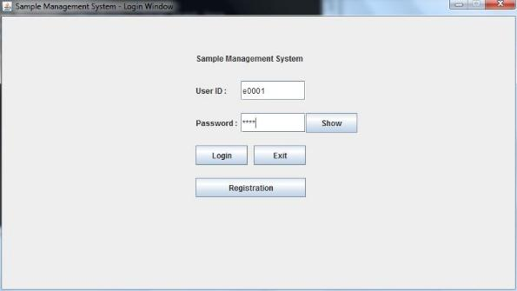
Graphical User Interface
Illustration of GUI Components
Label
TextField
PasswordField
Button
Frame

Slide 6
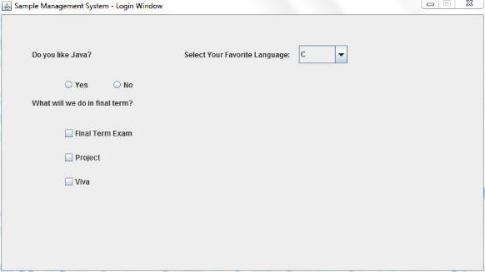
Graphical User Interface
Illustration of GUI Components
Drop Down List
Radio Buttons
Check Boxes

Slide 7
Graphical User Interface
Java library classes for making a GUI
All these GUI components can be created using java library classes. These classes are inside javax.swing package.
Name of Component | Java Library Class Name
Label | JLabel
TextField | JTextField
PasswordField | JPasswordField
Button | JButton
Radio Button | JRadioButton
Check Box | JCheckBox
Button Group | ButtonGroup
Drop Down List | JComboBox
Text Area | JTextArea
Image | ImageIcon
Table | JTable
Panel | JPanel
Frame | JFrame

Slide 8
Graphical User Interface
Customizing Color and Font
Color and Font of GUI components can be customized/changed by using the following library classes:
Color
Font
Both of these classes are in java.awt package. These classes have constructors to create color and font according to user preference. These user defined colors and fonts can be used for GUI components by calling library methods of their respective classes.
Constructors and Methods | Description
Color(int r, int g, int b) | Creates a color having the RGB value as per the parameters
setBackground(Color c) | Changes the background color as per the Color object passed in the parameter
setForeground(Color c) | Changes the font color as per the Color object passed in the parameter
Font(String name, int style, int size) | Creates a font having the name, style and size as per the parameter values
setFont(Font f) | Changes the font as per the Font object passed in the parameter

Slide 9
Graphical User Interface
Different Event Listeners
The following four are the frequently used event listeners:
ActonListener
MouseListener
KeyListener
FocusListener
All of these listeners are java library interfaces. They are inside the java.awt.event package. Each type of listener handles their own type of event.
EventListener | Event
ActionListener | ActionEvent
MouseListener | MouseEvent
KeyListener | KeyEvent
FocusListener | FocusEvent
A frame that wants to perform some operation or task whenever any event occurs, needs to implement the respective EventListeners.
As these event listeners are interfaces, our class has to override the all the abstract methods of the implemented interfaces.

Slide 10
Graphical User Interface
Different Event Listeners
The followings are the abstract methods that these interfaces have:
MouseListener
mouseClicked(MouseEvent me)
mousePressed(MouseEvent me)
mouseReleased(MouseEvent me)
mouseEntered(MouseEvent me)
mouseExited(MouseEvent me)
KeyListener
keyTyped(KeyEvent ke)
keyPressed(KeyEvent ke)
keyReleased(KeyEvent ke)
FocusListener
focusGained(FocusEvent fe)
focusLost(FocusEvent fe)
ActionListener
actionPerformed(ActionEvent ae)

Slide 11
Graphical User Interface
Steps to Design a GUI
We need to write a class to develop a GUI. The object of our class will be the GUI. It will be easier to develop a GUI, if we do the followings first:
Draw a sketch of the GUI in a paper.
Make a list of the components of the GUI.
Make a list of color and fonts that the components will have (optional).
Make a list of events that might happen in the GUI.
The followings steps should be followed while writing the class:
Step 0: Import Necessary library classes.
Step 1: Our class needs to extend the JFrame class and implement necessary listeners.
Step 2: The components used in the GUI will be the attributes of our class.
Step 3: The colors and fonts used in the GUI should also be in the attributes (optional).
Step 4: Write a constructor for the class. The body of the constructor can be divided into several parts:

Slide 12
Graphical User Interface
Steps to Design a GUI
(a) Initialize the Frame Header, the size of the frame.
(b) Create the panel object and set its layout as null.
(c) Initialize Custom Color and Custom Font (Optional).
(d) For each of the components (except for ImageIcon, JTable, ButtonGroup and JComboBox) follow the pattern of “Three Statements”.
1. Create an object for the component.
2. Initialize its size and position.
3. Add the component in the panel.
(e) Change color and font for the components and add necessary event listeners(optional).
(f) Add the panel in the frame.
Step 5: Override the abstract methods of the implemented listener interfaces.
Step 6: Write a main method in a separate class to create display the GUI.

Slide 13
Graphical User Interface
Steps to Design a GUI
Example
In Code

Slide 14
Books
Java Complete Reference, 7th Edition, By Herbert Schildt.
A Programmer’s Guide to Java™ SCJP Certification A Comprehensive Primer, 3rd edition, by Khalid A. Mughal and Rolf W. Rasmussen
Java How to Program Java, 9th Edition, By Deitel and Deitel.
The Java Language Specification, By J. Gosling, B. Joy, G. Steele, G.Bracha and A. Buckley
Introduction to Programming Using Java, 6th Edition, By David j. Eck
Head First Java, By Kathy Sierra and Bert Bates

Slide 15
References
Java Complete Reference, 7th Edition, By Herbert Schildt.
A Programmer’s Guide to Java™ SCJP Certification A Comprehensive Primer, 3rd edition, by Khalid A. Mughal and Rolf W. Rasmussen
The Java Language Specification, By J. Gosling, B. Joy, G. Steele, G.Bracha and A. Buckley
docs.oracle.com

